Slide 1
Comparative Genomics
Team: F (Group -4)

Slide 2
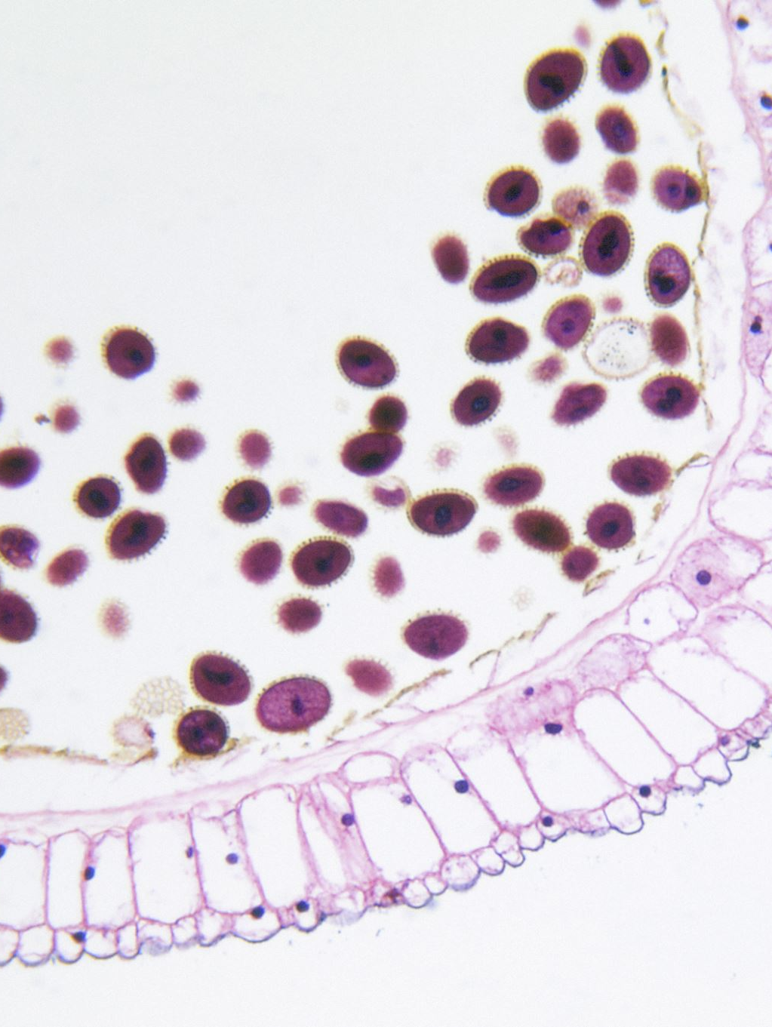
Introduction
Listeria is a genus of Gram-positive, facultatively anaerobic bacteria that are significant in public health due to their widespread distribution in natural environments and ability to adapt to various habitats.
Listeria monocytogenes, a pathogenic species within this genus, is responsible for causing listeriosis, a serious foodborne illness.
This presentation outlines the investigation of an outbreak using comparative genomics approaches.
The analysis aims to provide insights into the causative L. monocytogenes strain, its genetic characteristics, virulence factors, and antimicrobial resistance profiles.
Notes:
Pavithra

Slide 3

Objective 1: Identify the Causative Strain
A. Rapid Genome Comparison and Clustering:
Mashtree and gSearch enable fast comparisons of large datasets, allowing the identification of closely related genomes that potentially belong to the outbreak strain.
This initial clustering separates unrelated genomes, facilitating the focus on the relevant isolates.
Notes:
Pavithra

Slide 4
Mashtree
Bioinformatics tool for rapid bacterial genome clustering, pivotal in genomic epidemiology.
Utilizes min-hash and neighbor-joining algorithms to swiftly construct phylogenetic trees from genome sketches.
Offers support values via bootstrapping and jackknifing, enhancing tree reliability.
Supports diverse file types, multithreading for performance, and an SQLite database for result caching.
To install Mashtree, access the CPAN repository, follow the provided instructions, and verify the installation.
Notes:
Pavithra

Slide 5

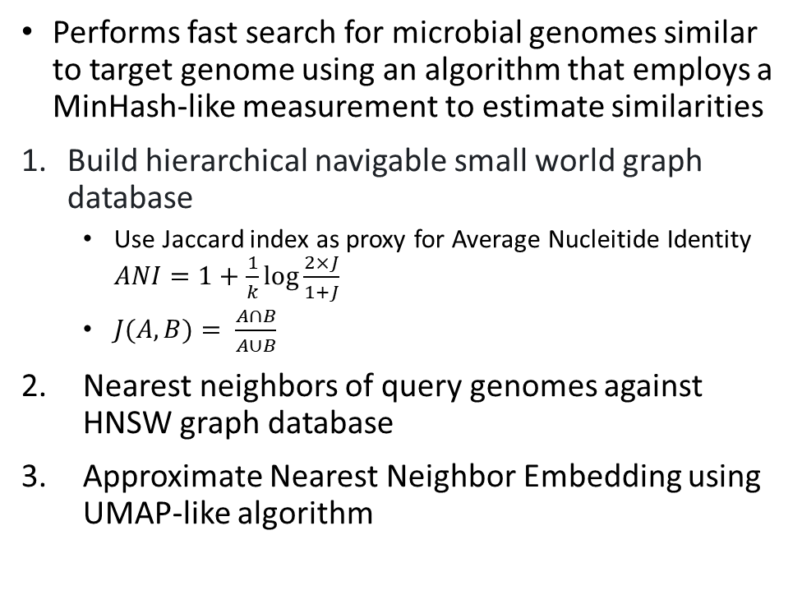
gSearch
Performs fast search for microbial genomes similar to target genome using an algorithm that employs a MinHash-like measurement to estimate similarities
Build hierarchical navigable small world graph database
Use Jaccard index as proxy for Average Nucleitide Identity $ANI=1+\frac{1}{k}\log{\frac{2×J}{1+J}}$
$J(A,B)= \frac{A∩B}{A∪B}$
Nearest neighbors of query genomes against HNSW graph database
Approximate Nearest Neighbor Embedding using UMAP-like algorithm
Notes:
Anna

Slide 6

sourmash
Performs metagenome analysis and genome comparison using k-mers and MinHash algorithm
Designed to quickly compare large sequences and sequence sets using MinHash techniques. Here are its key features and functionalities:
Effective for handling very large datasets.
Similarity searches between datasets and database and checks for containments checks
Scalability and Speed: Due to its use of MinHash sketches, Sourmash can handle comparisons among large datasets efficiently, making it well-suited for initial large-scale exploratory analyses.
Various input types, can operate on raw reads or assembled genomes.

Slide 7
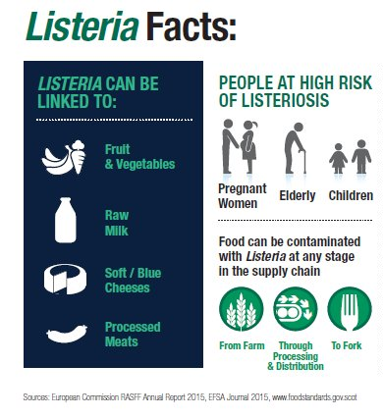
Objective 1: Identify the Causative Strain
B. High-Resolution SNP Analysis: Tools like ParSNP and lyve-SET perform detailed SNP-level comparisons among the identified cluster of genomes.
This high-resolution analysis aids in pinpointing the specific strain responsible for the outbreak.
Notes:
Anna

Slide 8
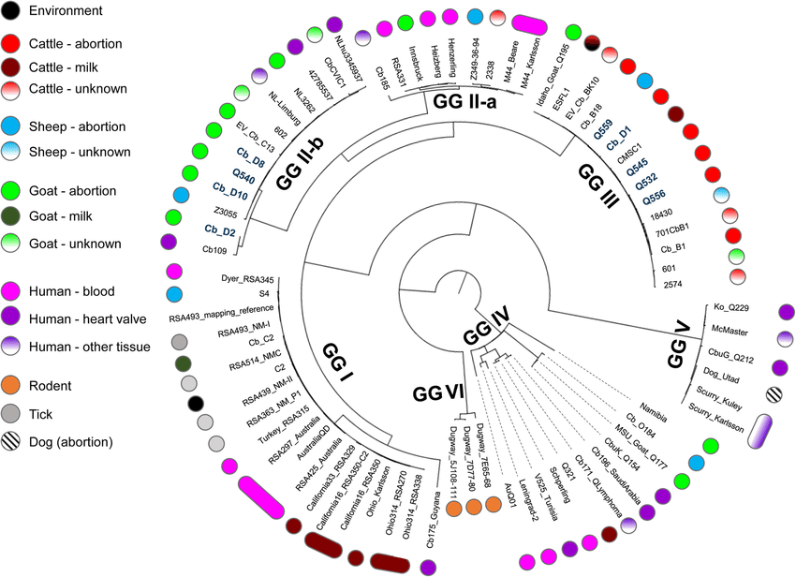
ParSNP
Quickly aligns closely related genomes, focusing on core genomes to construct phylogenetic trees that elucidate genetic relationships.
Progressive Mauve Algorithm: Iteratively aligns sequences by identifying locally collinear blocks (LCBs) and refining alignments to maximize similarity and minimize rearrangements.
Handles large-scale genomic rearrangements and variations in gene order.
The alignment generated by the Progressive Mauve algorithm provides information about the evolutionary distances between the genomes.
Output is in Newick format – further visualisation and analysis using external tools –iTOL (Interactive Tree Of Life).
Notes:
Khushi

Slide 9
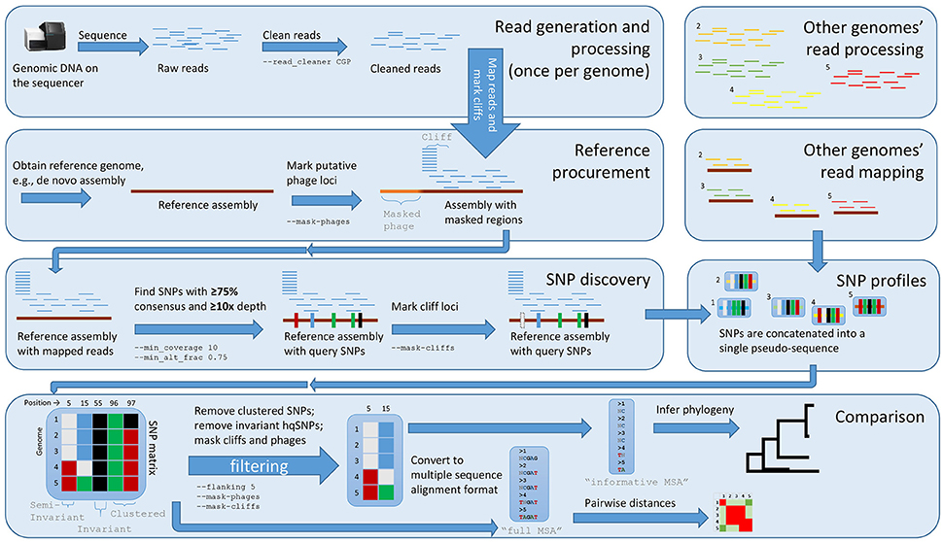
Lyve-SET
A whole-genome SNP-based phylogeny, analyze raw sequencing reads or assembled contigs to identify a core genome and produce a phylogenetic tree.
Identify high-quality SNPs (hqSNPs) in Listeria genomes, allowing for high-resolution phylogenetic analysis and comparison to other Listeria isolates
Lyve-SET has shown high concordance with whole-genome multilocus sequence typing (wgMLST) approaches for Listeria outbreak investigations.
Notes:
After 3rd point: providing equivalent phylogenetic results when interpreted in the context of epidemiological data.
Ayushi

Slide 10

Objective 2: Analyze Genetic Relationships and Differences Among Isolates
cgMLST (core genome MLST) will be used to analyze the genetic relationships and differences among isolates based on the variation in core genome loci.
Tools like RAxML, FigTree and FastTree construct phylogenetic trees based on the identified SNPs.
These trees visually represent the evolutionary relationships and genetic distances among the isolates, aiding in outbreak source tracing.
Notes:
Ramya

Slide 11
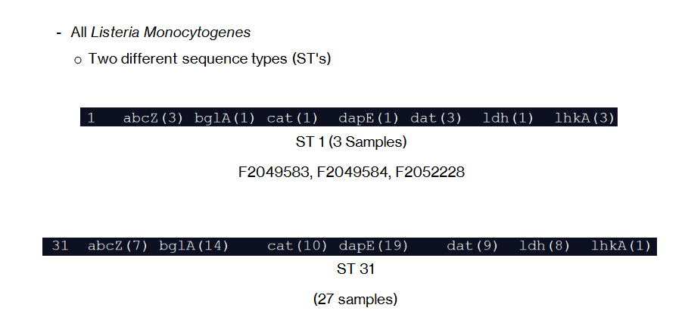
CgMLST (Ramya)
Core Genome MLST (cgMLST) is an extension of MLST that involves a much larger set of genes, typically encompassing the core genome, which consists of genes present in all members of a species.
Group 3 has already done MLST analysis. Results: 3 samples belong to ST1 and the rest 27 belong to ST31.
While MLST might differentiate between major lineages or clonal complexes, cgMLST can differentiate between closely related strains within these groups.
This is particularly useful in outbreak investigations where multiple isolates may share the same ST but can still be distinguished based on their core genome variations.
Notes:
Ramya

Slide 12

Visualization
Microreact: Allows users to visualize phylogenetic trees alongside relevant metadata. Useful for distinguishing between outbreak strains and sporadic strains, facilitating a comprehensive analysis and interpretation of the data.
Phandango: Simultaneous visualization of phylogenetic trees and genomic annotations, allowing for easy exploration of relationships between genetic variations and their biological implications.
Gingr (Harvest Suite): Interactive visualization capabilities tailored for SNP-based data, enhancing the user's ability to interpret and explore complex phylogenetic information effectively.
Notes:
Ramya

Slide 13

Objective 3: Differentiate Between Outbreak and Sporadic Strains
By combining the genomic data from SNP analysis and phylogenetic trees with epidemiological information, we will distinguish outbreak-related strains from sporadic or unrelated strains.
Isolates clustering together with strong genomic similarities and epidemiological links are likely associated with the outbreak.
Notes:
Anna

Slide 14

Objective 4: Characterize Virulence and Antibiotic Resistance Profiles
AMRFinder and PathoFact have been used to identify antibiotic resistance genes and virulence factors in the outbreak isolates.
AMRFinder will be utilized more comprehensively to identify additional antimicrobial resistance genes.
Comparing these profiles against other strains/references enables identification of unique outbreak-contributing characteristics.
Notes:
Anna

Slide 15
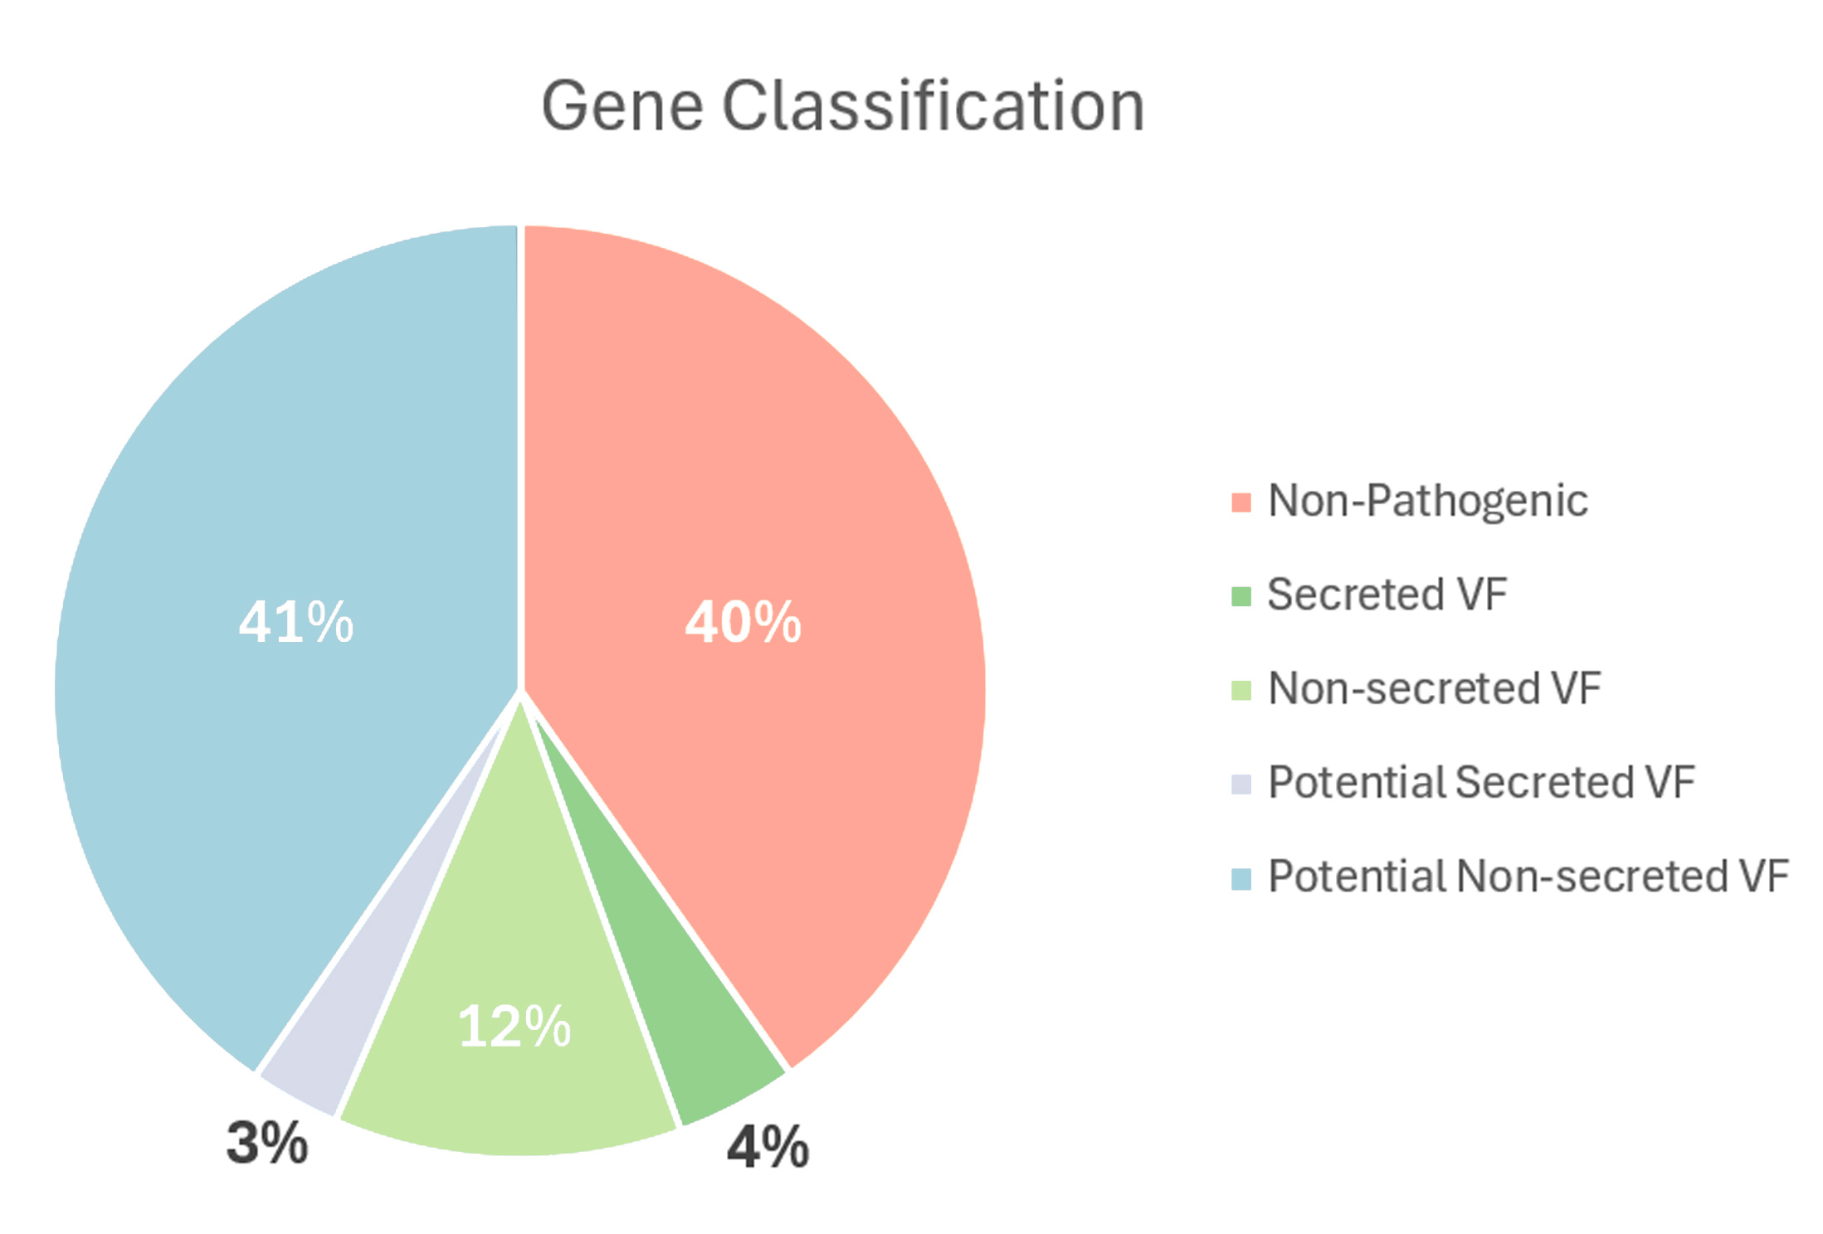
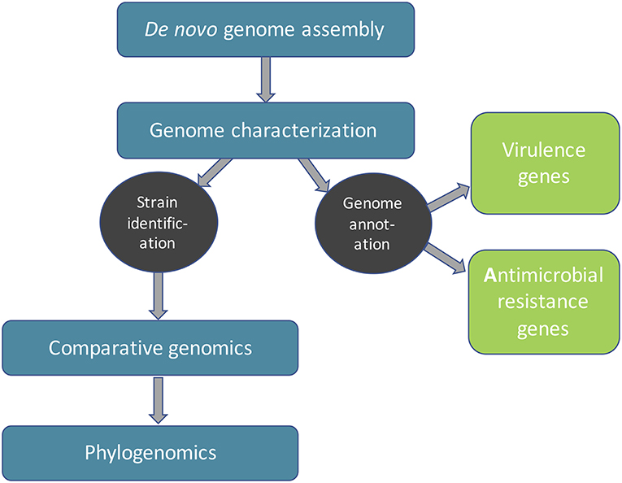
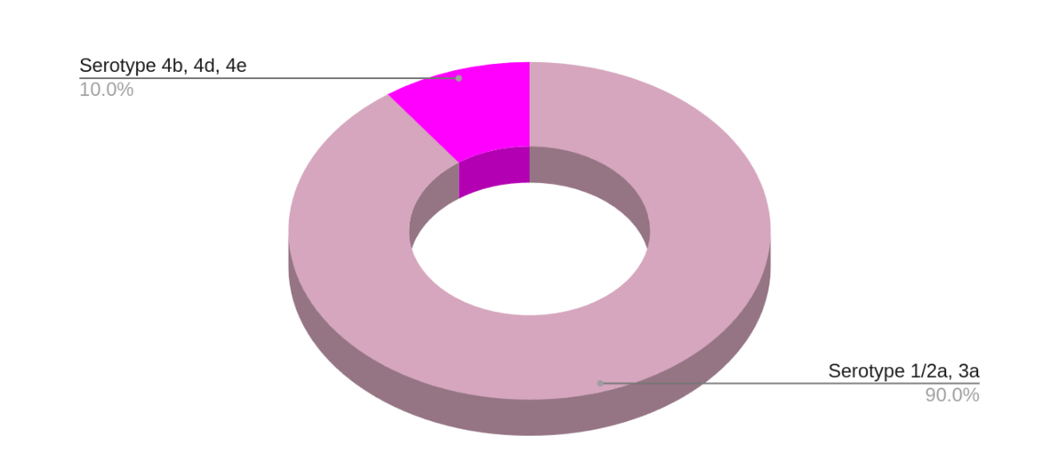
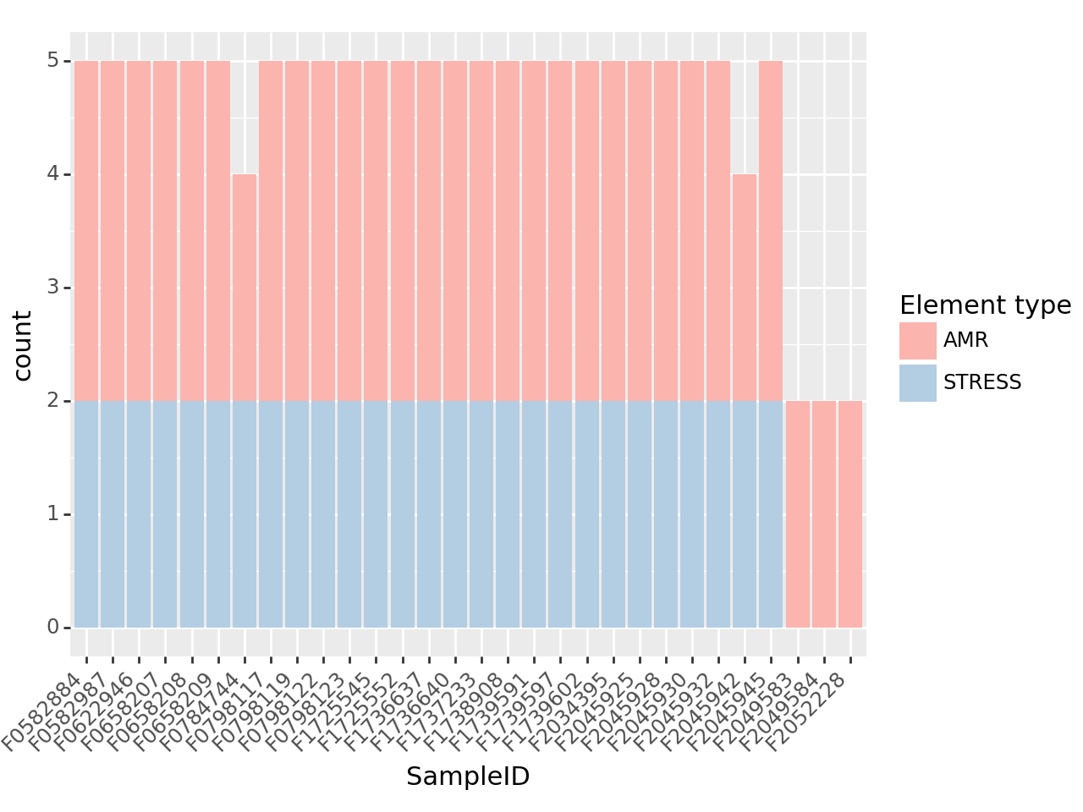
Notes:
Khushi
Ouput from grps 2 & 3 – gonna use that for out work – grp3 taxonimic assessment – gonna use similar tools

Slide 16
Workflow
Rapid genome comparison and clustering to identify potential outbreak-related isolates and remove unrelated genomes.
High-resolution SNP analysis on the identified cluster to determine genetic relationships and differences among isolates.
Virulence and resistance profiling to characterize the pathogenicity and antimicrobial resistance profiles of the outbreak isolates.
Phylogenetic analysis and visualization to construct and annotate phylogenetic trees, aiding in the differentiation of outbreak and sporadic strains.
Integration of genomic and epidemiological data to corroborate findings and provide actionable recommendations.
Notes:
Khushi

Slide 17
Timeline
 | 4/11/24 – 4/13/24 |  |  | 4/14/24 – 4/20/24 |  |  |  |  |  |  | 4/21/24 – 4/23/24
Analysis | T | F | S | S | M | T | W | T | F | S | S | M | T
Rapid Genome Comparison and Clustering Anna Pavithra
Determine genetic relationships and differences Ramya Ayushi Khushi
Virulence and Resistance Profiling Anna
Reporting and Visualization All
Presentation All
Notes:
Khushi

Slide 18
Tool Name | Type of Analysis | Key Features
Mashtree | Rapid Genome Comparison | - Uses mash-based approach for fast clustering. Efficient for large datasets
gSearch | Rapid Genome Comparison | - New method for rapid genome comparisons. Designed to evaluate performance in large datasets
ParSNP | High-Resolution SNP Analysis | - Assembly-based SNP analysis. High-resolution comparisons for closely related genomes
lyve-SET | High-Resolution SNP Analysis | - Read-based SNP analysis. Extensive filtering options for diverse data quality
Roary | Virulence and Resistance Profiling | - Rapid pan-genome analysis. Identifies core and accessory genes including virulence genes
AMRFinder | Virulence and Resistance Profiling | - Identifies antimicrobial resistance genes, virulence factors, and other gene elements. Utilized in conjunction with PathoFact for comprehensive resistance and virulence profiling
RAxML | Phylogenetic Analysis | - Constructs maximum likelihood phylogenetic trees. Accurate for large datasets
FastTree | Phylogenetic Analysis | - Fast construction of phylogenetic trees. Balances speed with accuracy
FigTree | Visualization | - Specialized in visualizing phylogenetic trees
Microreact | Visualization | - Integrates phylogenetic trees with metadata such as geographical and temporal data for comprehensive visualization
Phandango | Visualization | - Interactive visualization of phylogenetic relationships alongside genomic features
Notes:
Khushi

Slide 19
References
Katz, L. S., Griswold, T., Morrison, S. S., Caravas, J. A., Zhang, S., den Bakker, H. C., ... & Carleton, H. A. (2019). Mashtree: a rapid comparison of whole genome sequence files. Journal of Open Source Software, 4(44).
Zhao, J., Both, J. P., Rodriguez-R, L. M., & Konstantinidis, K. T. (2022). GSearch: Ultra-Fast and Scalable Microbial Genome Search by Combining K-mer Hashing with Hierarchical Navigable Small World Graphs. bioRxiv, 2022-10.
Treangen, T. J., Ondov, B. D., Koren, S., & Phillippy, A. M. (2014). The Harvest suite for rapid core-genome alignment and visualization of thousands of intraspecific microbial genomes. Genome biology, 15, 1-15.
Jackson, B. R., Tarr, C., Strain, E., Jackson, K. A., Conrad, A., Carleton, H., ... & Gerner-Smidt, P. (2016). Implementation of nationwide real-time whole-genome sequencing to enhance listeriosis outbreak detection and investigation. Reviews of Infectious Diseases, 63(3), 380-386.
Katz, L. S., Griswold, T., Williams-Newkirk, A. J., Wagner, D., Petkau, A., Sieffert, C., ... & Carleton, H. A. (2017). A comparative analysis of the Lyve-SET phylogenomics pipeline for genomic epidemiology of foodborne pathogens. Frontiers in Microbiology, 8, 375.
Chen, Y., Gonzalez-Escalona, N., Hammack, T. S., Allard, M. W., Strain, E. A., & Brown, E. W. (2016). Core genome multilocus sequence typing for identification of globally distributed clonal groups and differentiation of outbreak strains of Listeria monocytogenes. Applied and environmental microbiology, 82(20), 6258-6272.
Argimón, S., Abudahab, K., Goater, R. J., Fedosejev, A., Bhai, J., Glasner, C., ... & Aanensen, D. M. (2016). Microreact: visualizing and sharing data for genomic epidemiology and phylogeography. Microbial genomics, 2(11), e000093.
Hadfield, J., Croucher, N. J., Goater, R. J., Abudahab, K., Aanensen, D. M., & Harris, S. R. (2018). Phandango: an interactive viewer for bacterial population genomics. Bioinformatics, 34(2), 292-293.
Wang, Q., Holmes, N., Martinez, E., Howard, P., Hill-Cawthorne, G., & Sintchenko, V. (2015). It is not all about single nucleotide polymorphisms: comparison of mobile genetic elements and deletions in Listeria monocytogenes genomes links cases of hospital-acquired listeriosis to the environmental source. Journal of Clinical Microbiology, 53(11), 3492-3500.
Brown et al, (2016), sourmash: a library for MinHash sketching of DNA, Journal of Open Source Software, 1(5), 27, doi:10.21105/joss.00027

Slide 20
Thank You!
Any questions?

